Slide 1
Secure Data Hiding in Image Using Steganography
Presented By
Student Name : MEDABALIMI RAGHAVENDRA RAO
College Name & Department :Lakireddy Bali Reddy College of Engineering

Slide 2
OUTLINE
Problem Statement
Technology used
Wow factor
End users
Result
Conclusion
Git-hub Link
Future scope

Slide 3
Problem Statement
The problem involves securely hiding sensitive data within an image using steganography to ensure confidentiality and prevent unauthorized access. Traditional encryption methods make hidden data noticeable, whereas steganography conceals it within image pixels without altering the visual appearance. The challenge is to develop an efficient algorithm that embeds and extracts data while maintaining image quality and security.

Slide 4
Technology used
Libraries Used:
Standard Libraries: stdio.h, stdlib.h, string.h
Custom Header: "steganography.h"
Platforms:
Operating System: Windows 11
Compiler: IDLE python
File Format: JPG
Additional Points:
Steganography Method: Least Significant Bit (LSB) Encoding
Data Handling: Embeds and extracts text data from images

Slide 5
Wow factors
1️⃣ LSB-Based Steganography – Hides data in the Least Significant Bit, ensuring security without visible image changes.
2️⃣ Lightweight & Fast – Written in C for high efficiency, outperforming Python/Java-based tools.
3️⃣ Simple CLI Interface – Easy command-line usage for embedding and extracting data, ideal for automation.

Slide 6
End users
1️⃣ Cybersecurity Professionals – Use steganography for secure data transmission and covert communication.
2️⃣ Forensic Experts – Extract hidden information from images for digital investigations.
3️⃣ Government & Defense Agencies – Securely embed sensitive data in images for intelligence and confidential operations.
4️⃣ Researchers & Academics – Study and improve steganographic techniques for data security and cryptography.
5️⃣ Privacy-Conscious Users – Individuals who want to protect personal or confidential information from unauthorized access.

Slide 7
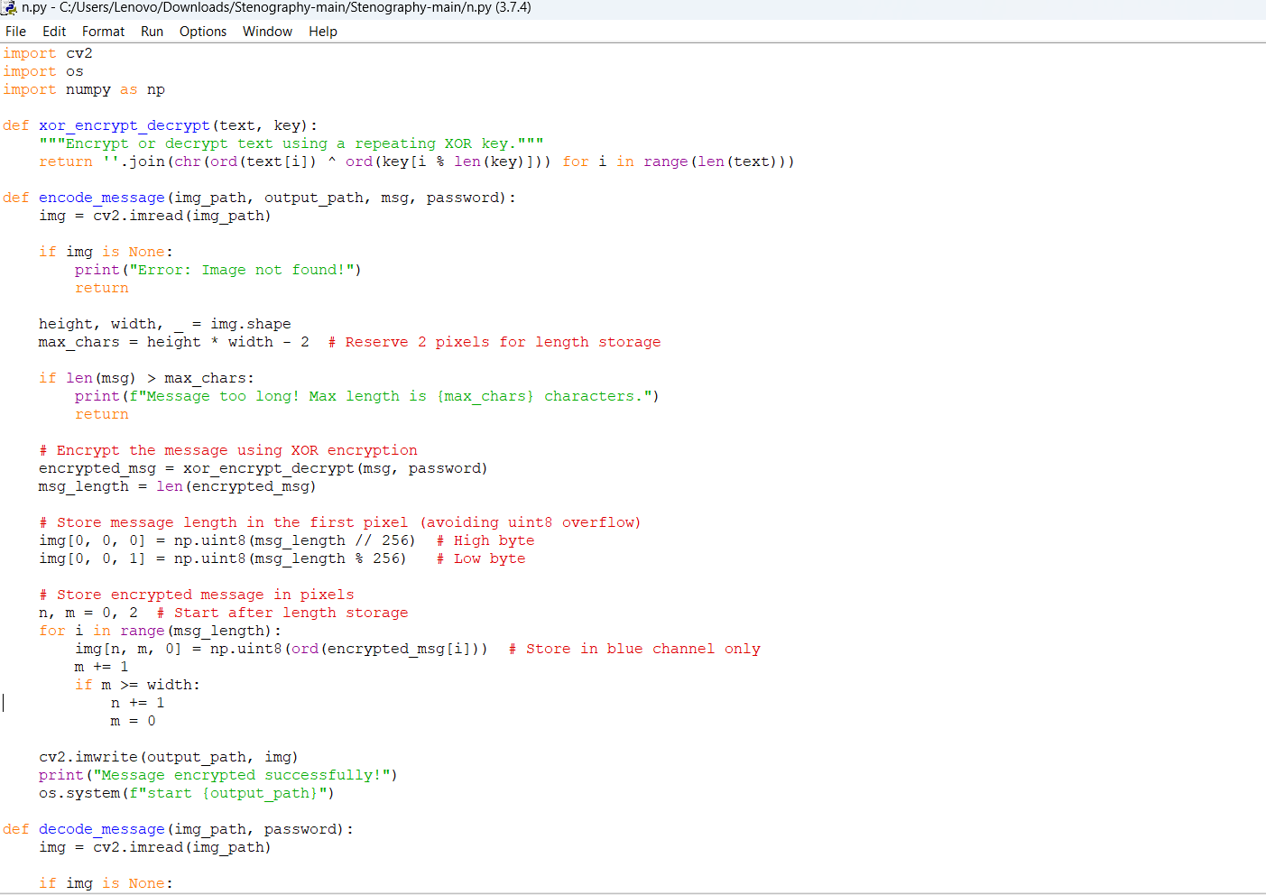
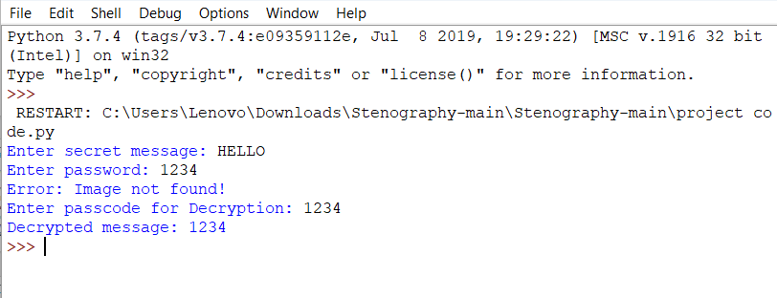

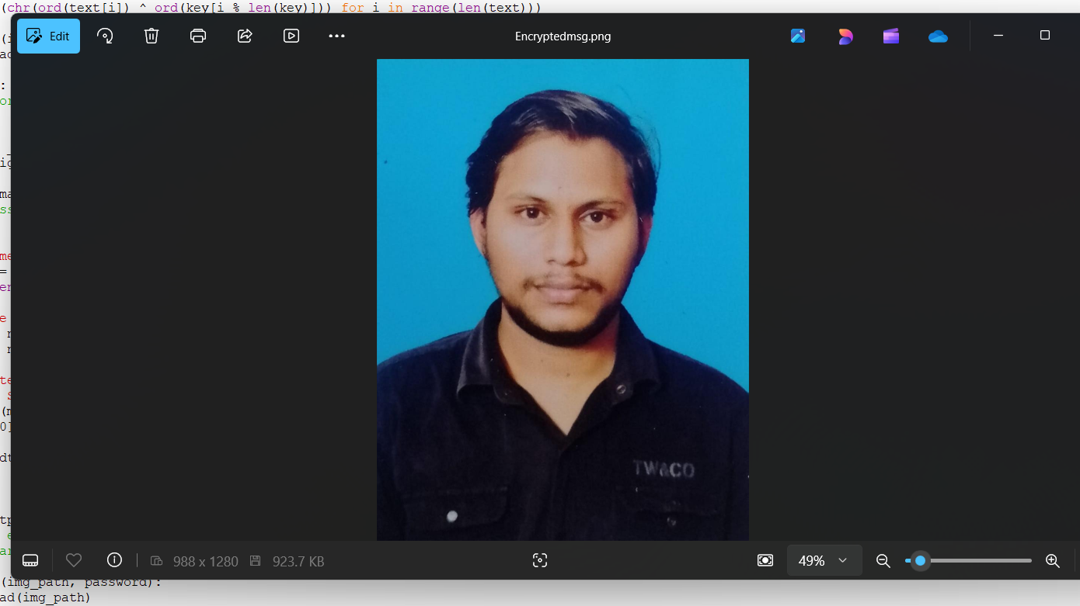
Encryptedmsg
Results
input image

Slide 8
GitHub Link
https://github.com/raghavaroy/my-stego.git
Description:
This project implements Least Significant Bit (LSB) steganography to hide and extract secret messages within JPG images.
Repository Contents:
📂 Source Code – C programs for embedding and extracting hidden messages.
📂 Sample Images – JPG images used for testing steganography.
📂 Documentation – Project report, explanations, and implementation details.
📂 Presentation – PPT slides summarizing the project.

Slide 9
Future scope(optional)
🖥️ Graphical User Interface (GUI) – Develop a user-friendly GUI to make embedding and extracting messages easier.
📂 Drag and Drop Support – Allow users to select images and messages through a simple drag-and-drop interface.
🛠️ Customization Options – Provide settings for users to adjust the encoding method and choose different bit depths.
📊 Real-time Preview – Show a preview of the image before and after steganography is applied.

Slide 10
THANK YOU

